Slide 1

“The wages of sin is death, but the free gift of God is eternal life in Christ Jesus our Lord.”
Romans 6:23 ESV
Notes:
It has often been said that Christianity is just for people with problems.
That’s true,… because we ALL have a very BIG problem, the problem of evil.
No human being has ever escaped the temptation to sin according to James 1v14.
What are the consequences ?
We all are condemned to die for our sin : the strongest, the richest, the most loved… we will all face death some day ! [read]
M/A 171210 avec notes / 180128 English Lafayette CA / 180708 Tulsa OK / 180715 N August SC /
Écran settings 100% de1366x768px.
Animation Pane 50/50 et diapos mini.
10 lignes max de notes avec Zoom 200% & diapos ci-dessus en face de diapo 10.
Lignes de cette longueur maximum>>>>
Presenter View > diapo mini à gauche & rien en haut avec zoom notes 2x.

Slide 2
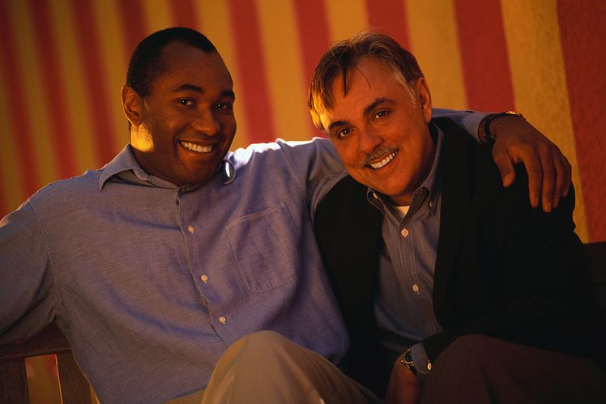
There is a Savior !
Notes:
There IS Good News !
That’s the meaning of the word “Gospel”.
Lk2:10-11 say, “I bring you Good News of great joy that will be for all the people. For unto you is born this day in the city of David a Savior, who is Christ the Lord.”
But, that was 2,000 years ago !
A Savior but, how does He save today ?
What does He do when someone is saved ?
What exactly is salvation ?

Slide 3
What do we offer the world ?
What are we looking for when we bring someone to the Lord Jesus Christ ?
Personal Salvation
Notes:
I find most Christians forget to explain the offer of salvation when they witness.
Let’s look in the Bible for what it says about personal and eternal salvation.
Let’s remember the Mission that Christ left for believers, summarized in 5 Key Verses : Ac 1:8, Lk 8:11, Lk1:17, Jonah 2:9 and Mt 28:19-20.
Salvation is a MIRACLE, not just a faith, like other religions !

Slide 4

Salvation is like a diamond.
It has many facets !
Notes:
Let’s look in the Bible for what it says about personal and eternal salvation.
I have prepared a summary of some of the key words used in the Bible to describe what God does in a flash, the moment someone is saved. [offer handouts]
Notice that there is a key verse for each facet of salvation.
Keep this list in your Bible to remember what Christ’s offer of salvation really is !

Slide 5
Christ removes sin !
“Behold, the Lamb of God,
who takes away
the sin of the world !”
John 1:29 ESV
This is more than forgiveness.
Notes:
Let’s look at the 2nd part of the MIRACLE of salvation that is linked to forgiveness.
Before the sacrifice of Christ on the Cross, sins were covered but, not removed.
There was a reminder every year(Heb10:3)
The blood of animals covered sin, but did not take it away. [read]
OT believers were truly forgiven, according to Lev4:26, but not w/o a record.
Ours is truly a great salvation. (Heb2v3)

Slide 6
No more record of sin
“I will be merciful toward their iniquities, and I will remember their sins no more.” Hebrews 8:12
God does what we can’t !
Notes:
Like a police record which disappeared, God is capable of removing all trace of sin.
This is truly a miracle. (read)
No matter what you have done, He can erase even the memory.
We can forgive others, but we cannot say what God does in this promise given in the Old for the New Testament. (Jer33:8)
True Salvation is not just a belief, a hope nor a mind set… it’s a miracle !

Slide 7
So great a salvation !
“God had provided something better for us, that apart from us they should not be made perfect.” Hebrews 11:40
Now it’s immediate and final.
Notes:
Salvation has always been by grace through faith, before the Cross and after.
After the death and resurrection of Christ, the fact is that our salvation is even greater !
How can that be ? [read]
Today we are discovering one of those facets of salvation that is so great.
All who receives Christ as Savior today immediately have their sins removed.
OT saints had to wait until the Cross !

Slide 8
He puts away our sin.
“He (Christ) has appeared once for all at the end of the ages to put away sin by the sacrifice of himself.
Hebrews 9:26 ESV
Once paid, now spent !
Notes:
This has to be more than just a figure of speech.
It’s a true historical act of God !
Just as it is a historical fact that Jesus came into this world, so it is a historical fact that He puts away sin by His sacrifice. [read]
Like redemption, Christ paid the price at the Cross, but spends the credit on all who trust Him enough to call on Him for salvation.
It’s ONCE for ALL with nothing to add !

Slide 9
What must we do ?
“Repent therefore, and turn back, that your sins may be blotted out.”
Acts 3:19 ESV
Your sins can be Forgiven AND removed by God.
Notes:
There is nothing we can do to remove our sins.
The removal of our sins is assured when God performs the MIRACLE of salvation.
If we do our part, He will do His ! [read]
People may remember your sins, but God has the power to blot them out.
So the miracle of the removal of our sins goes far beyond the miracle of forgiveness.
It clears the record of all we have done.

Slide 10
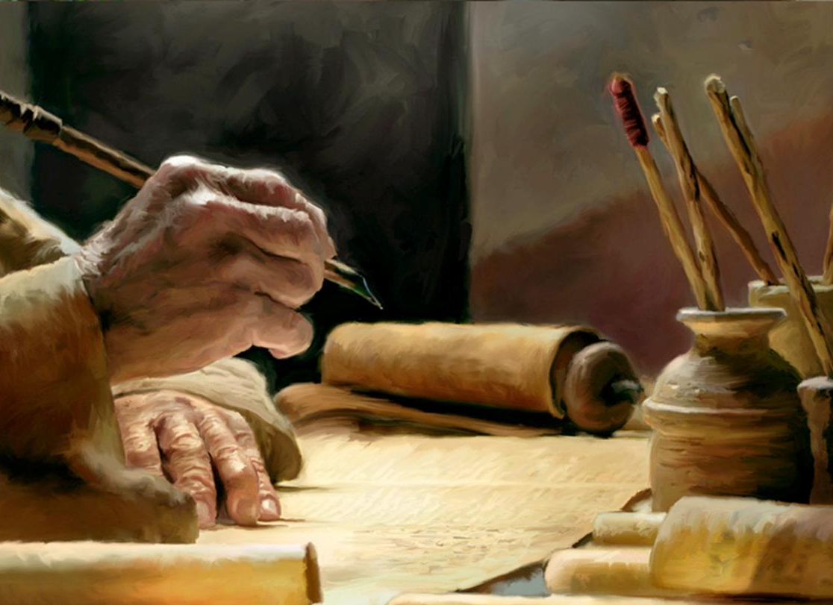
Notes:
God blots out forever the records of all our sins !
But, you must trust Christ enough to ask Him to save you according to Rm10:13.
Have you done that ?
What a great salvation He offers to all who will trust Him enough to ask for it.
The removal of our sins is the foundation of Justification and Christian liberty, that we will explore another time.

Slide 11
Review, React and Return !
Why lead others to Christ ?
For the Lord Jesus Christ to do the miracle of forgiving their sins.
Luke 24:46-48
So He will do the miracle of blotting out of their sins forever.
Acts 3:19
www.AzBible.yolasite.com
Notes:
The 3 R’s of education are not Reading, Writing and Arithmetic !
The big question today is this. [read]
[read]
[read]
That’s only 2 of over 24 aspects of personal salvation that are listed on the summary sheet given out today.
What a “great salvation” we have to offer the world around us !

