Slide 1

50 years of Mission France
Notes:
Automatic presentation with French Christian music that takes 9 minutes.

Slide 2

Mission France
Paris 1973
Moulins 1983
Vichy 2000
Savoie 1981
Thiel 2012
Jesus said in Matthew 16v18,
« I will build my church. »
Notes:
2008 Trip to USA - Created 081220
Nashville Gospel Chapel 2008
Church of Grace, Nashville 2008
Palms Bible Chapel, Phoenix, AZ – Revised 110309 + 130303 automatic
Tucson, AZ – revision 130310
Nashville GC 130317 Revision 2k3bis
Donelson, TN 130320
Meridian, ID – 130403
Stratford, IA – 130407 revision to 40yrsInFr = first offer of trips
13 assemblies on East Coast 4/13 to 5/13
SF Bay Missionary Conf – 130601 revison = shorter Vichy info.
Westbay GC, Edmonton, Alberta – 150209
Wyecliff GC, Edmonton, Alberta – 150211 = revised version
Atlanta, CA – 150908 revision
Land O Lakes, FL – 150920 revision
Pleasant Hill, CA – 160214 revision
Summer 2016 A Cross America With Christ…

Slide 3
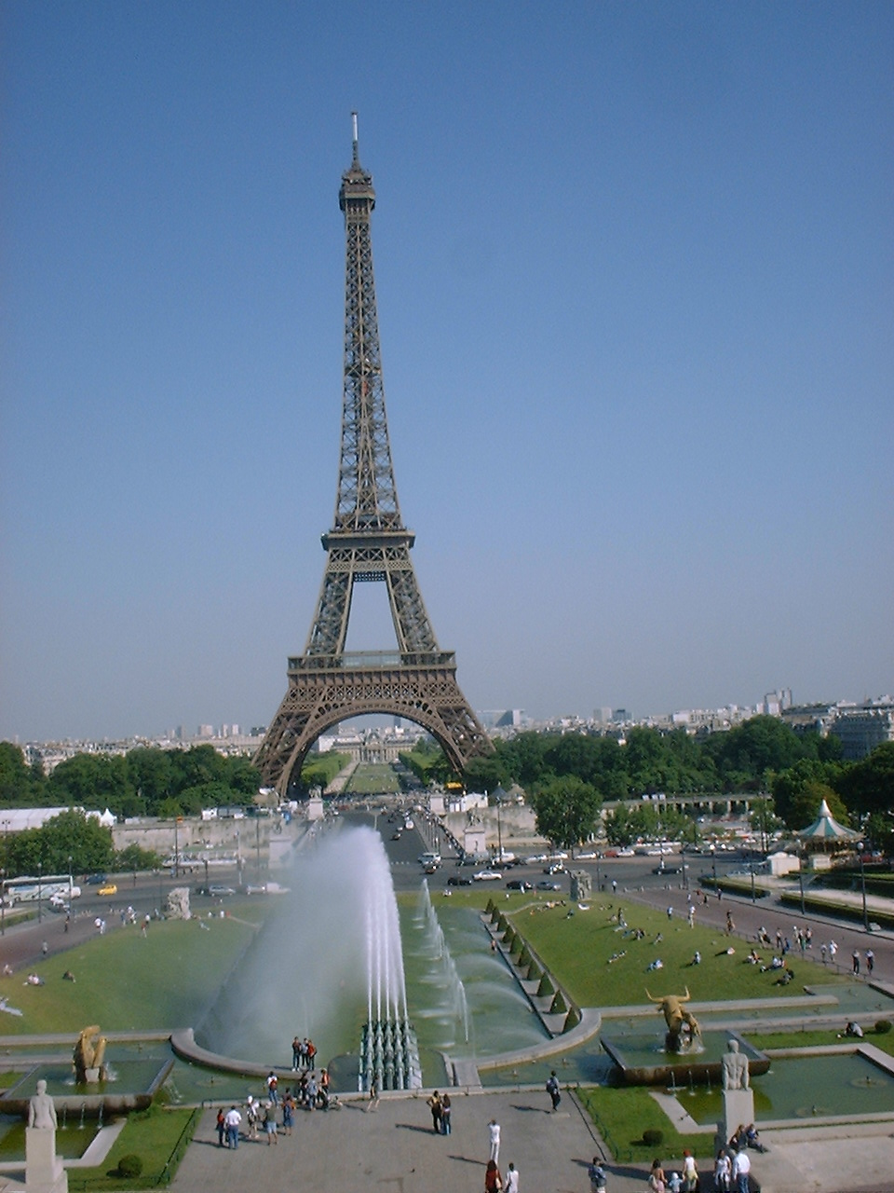
Commended in 1972, we arrived in Paris.

Slide 4
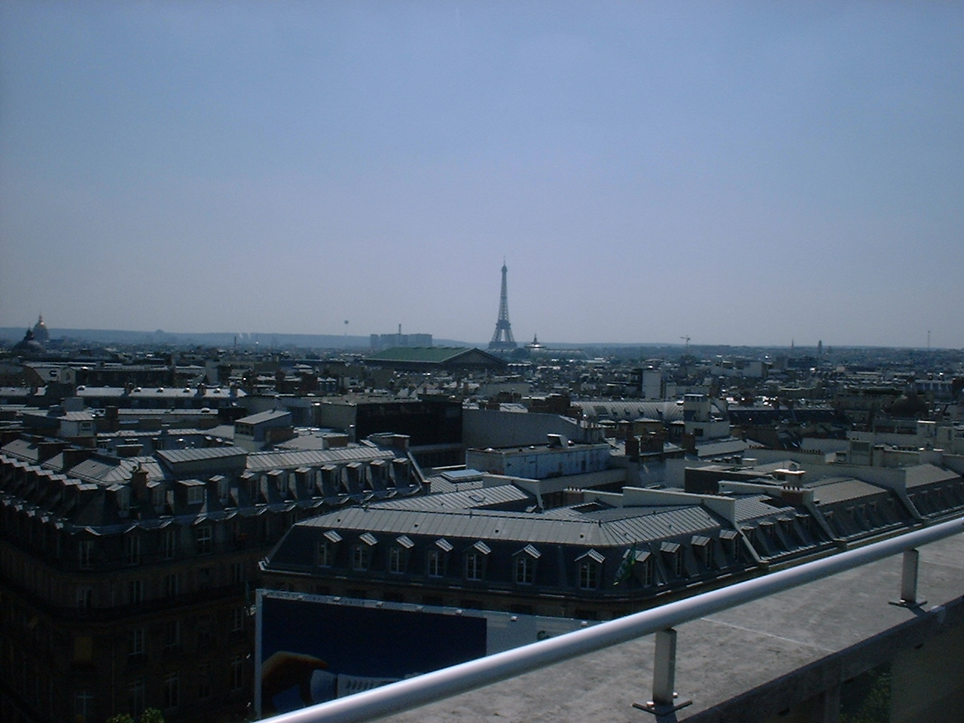
France was a mission field of 50 million and now over 66 million people, of which six million are legal Arab residents.
Notes:
161106 Wekipedia pop facts on internet

Slide 5
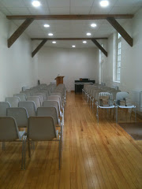
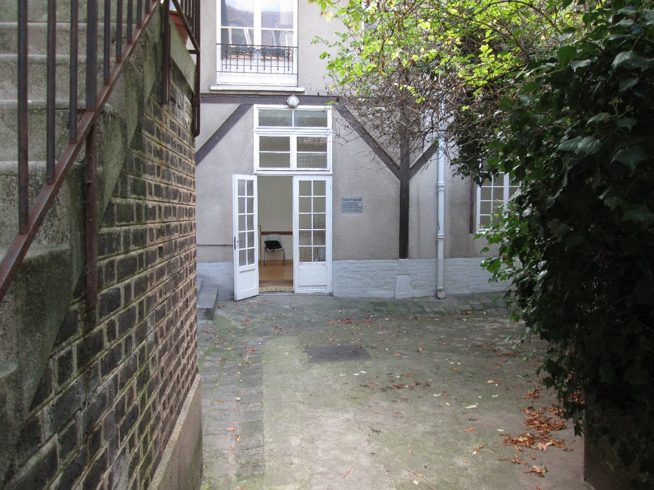
"Les Gobelins" Paris 13e
We found one of the first New Testament assemblies located inside Paris.

Slide 6
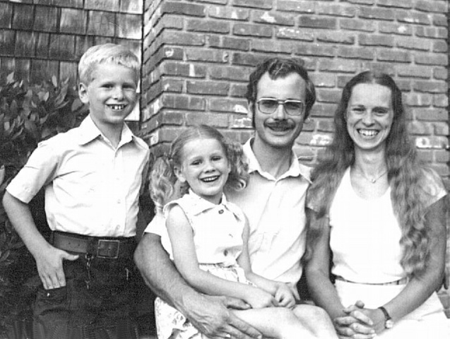
We were commended by two more assemblies in 1981…

Slide 7

...and began work in the Savoie,

Slide 8
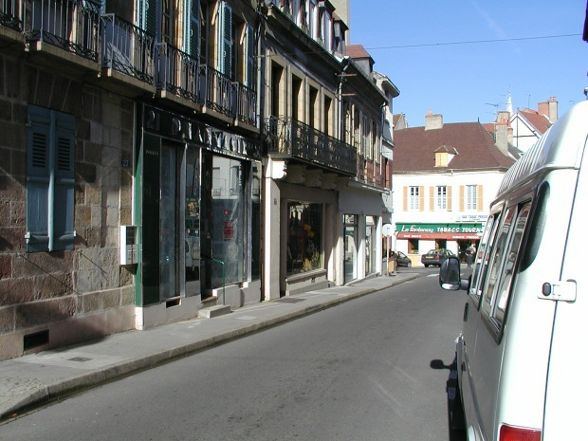
The Lord led us, in 1983, to pioneer a new work in Moulins s/Allier.

Slide 9
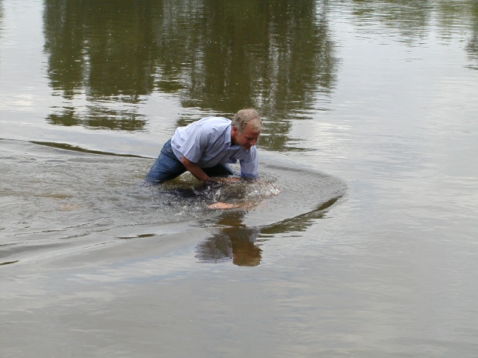
There were many river baptisms, as the Lord saved people.

Slide 10
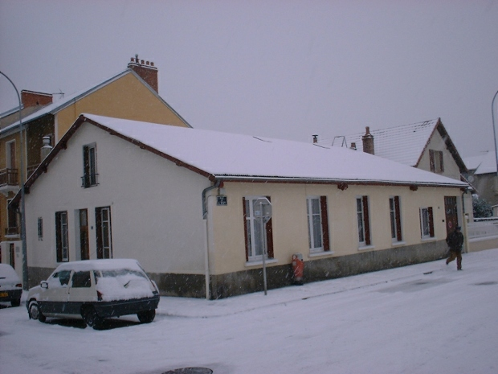
Faith and I moved to serve the Lord in Vichy during January 2000.

Slide 11
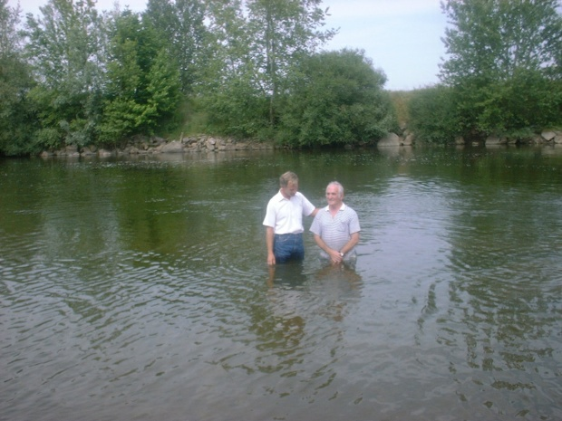
There were more river baptisms.

Slide 12
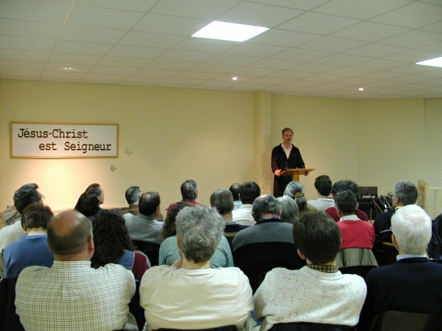
We started regional meetings.

Slide 13
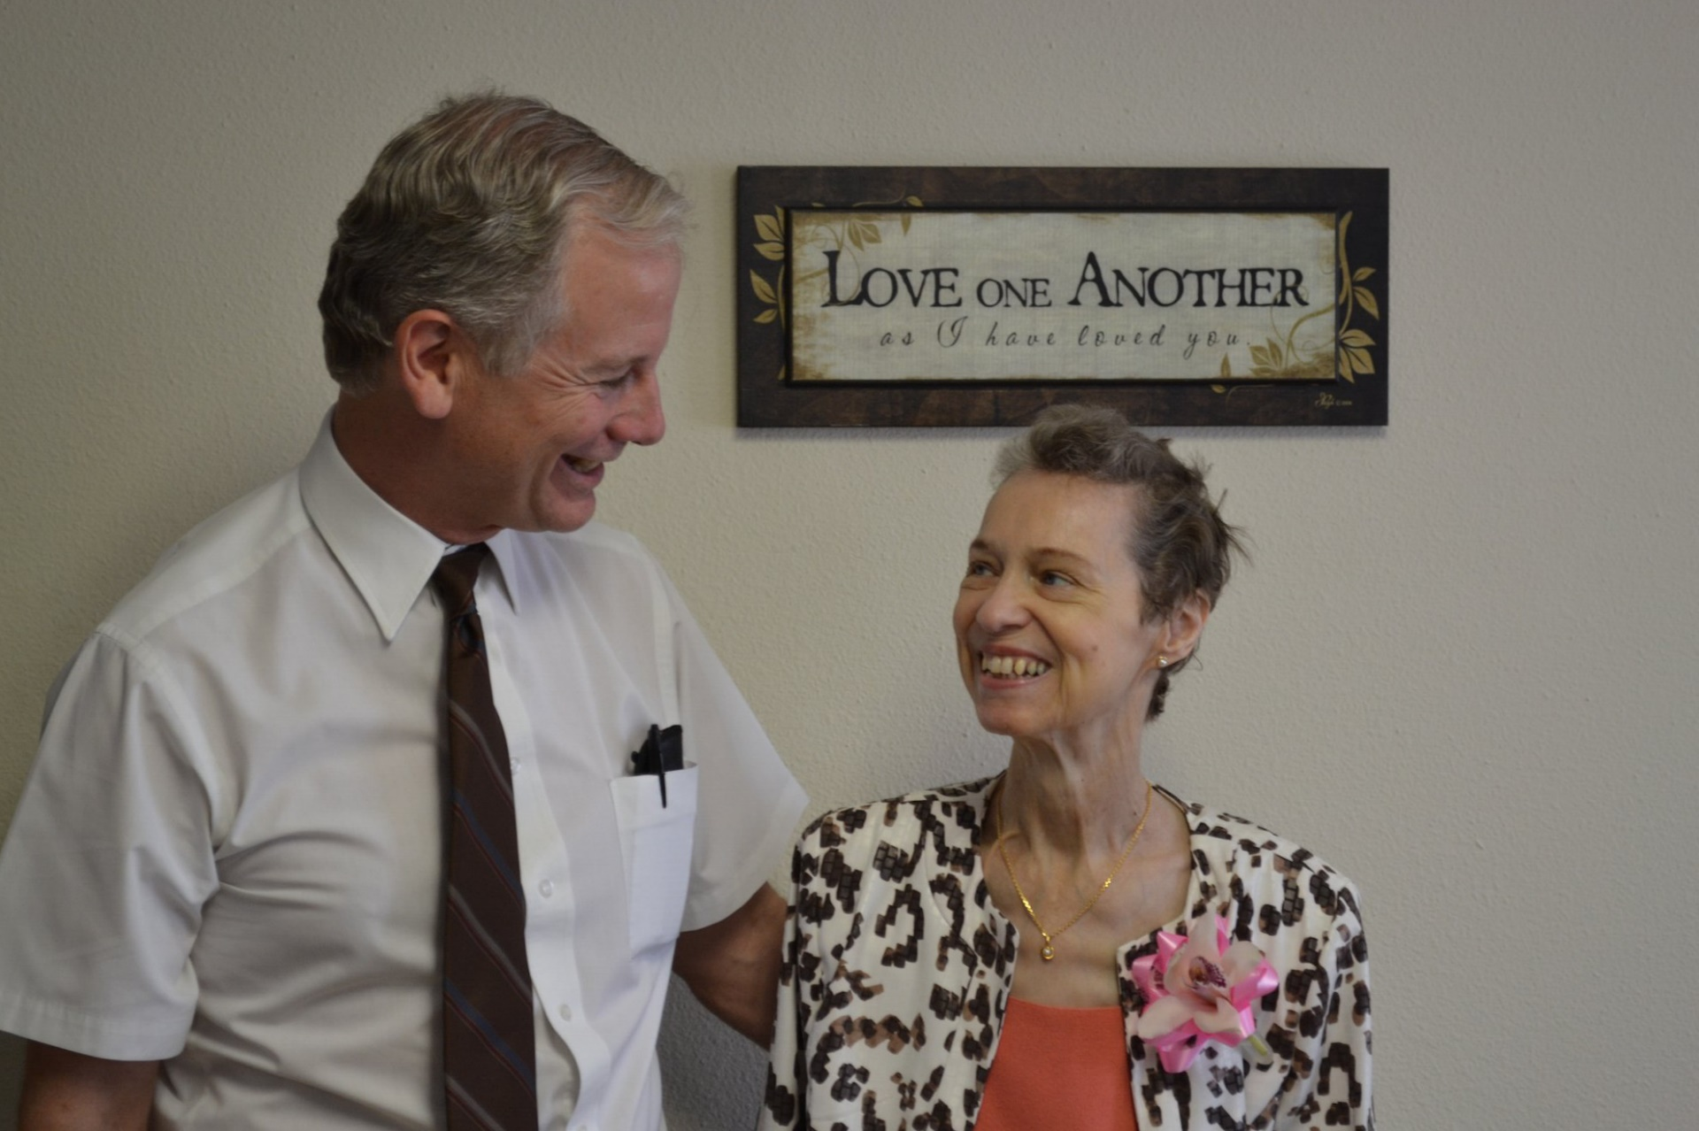
Faith moved up to Heaven in 2012.

Slide 14
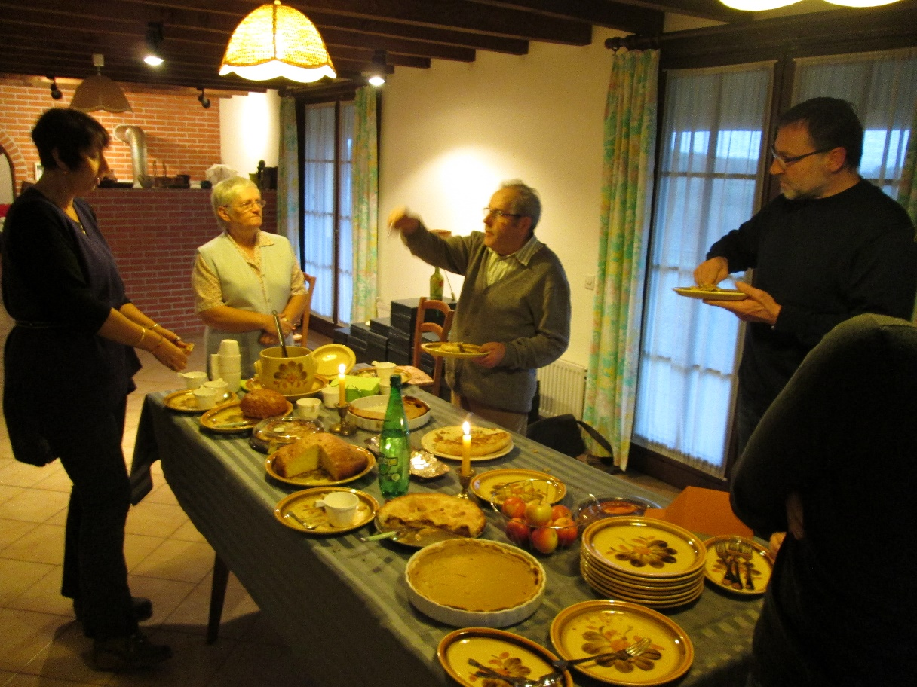
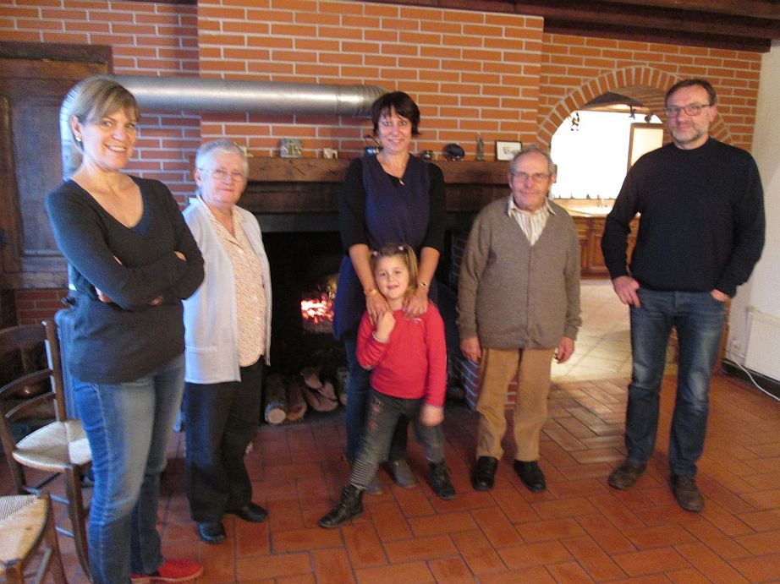
So I continue to lead others to Christ at my home in France and across the country in an itinerant ministry.

Slide 15
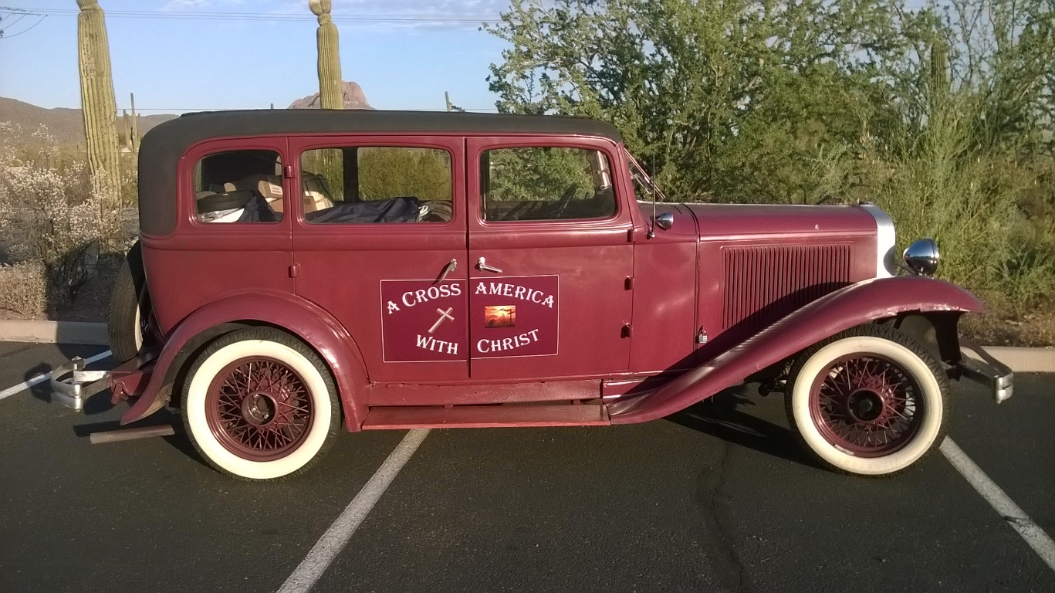
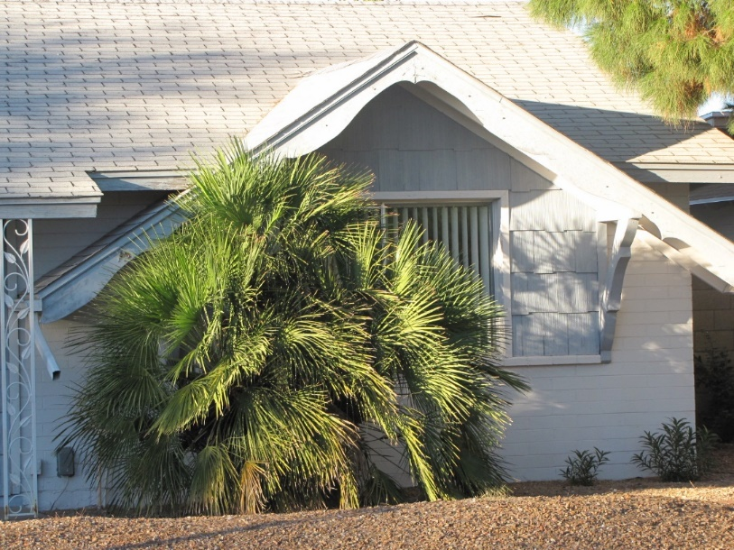
In North America, I have a legal residence in Phoenix, AZ, but I travel most of the time “A Cross America with Christ” to teach and lead others to Christ.

Slide 16
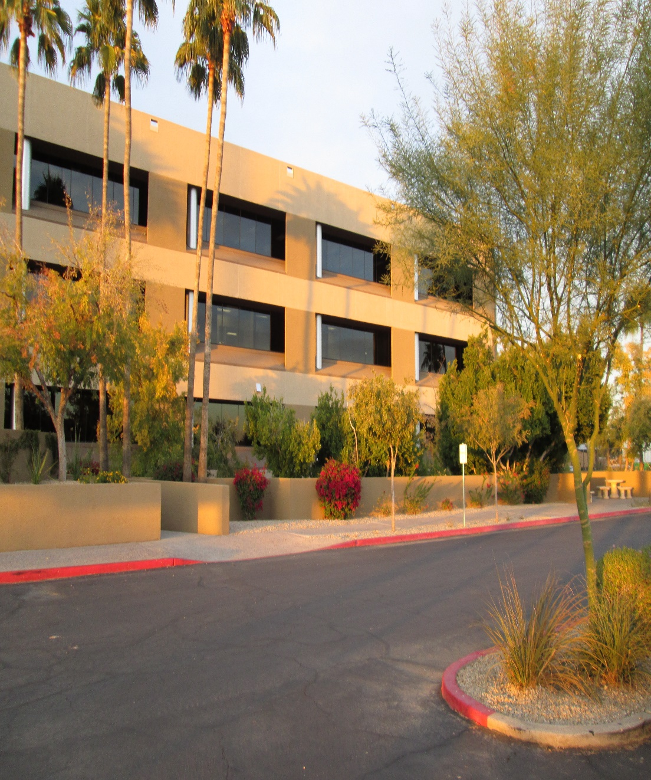
Spring and Fall
France
Summer and Winter
North America
Pass4missions.yolasite.com/latest-news

Slide 17
Please pray with me for France:
For even more people to be saved
For all believers to become soul winners
For more to head the call to missions
For assemblies to seriously study the Word of God. www.AzBible.yolasite.com
For publishing of electronic books for…
www.e-Sword.org at BibleSupport.com
www.Pass4missions.yolasite.com

