Slide 1
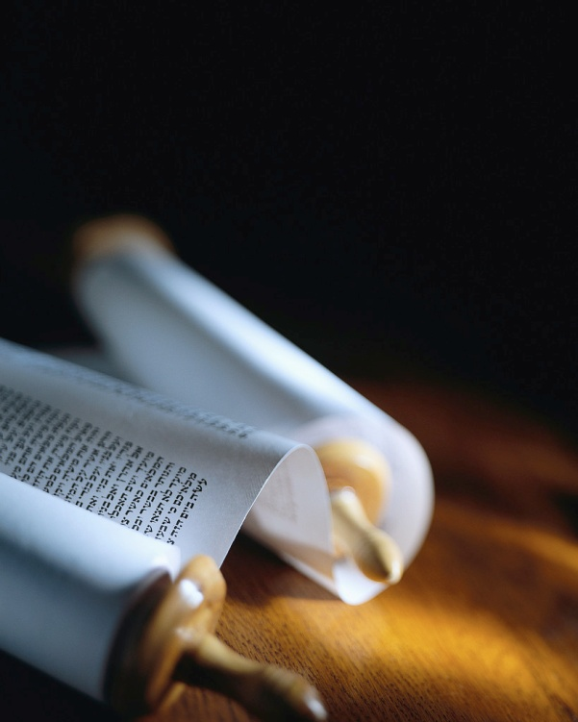
Next
Notes:
Good morning !
Let’s remember the mission of every believer :
1) You will be My witnesses. A1v8
2) The Seed is the Word. Lk8v11
3) Become Fishermen. Mk1v17
4) Salvation is of the Lord. Jo1v9
5) Make disciples. Mt28v19

Slide 2
Signs of Salvation
He [Andrew] led Simon to Jesus. Jesus looked at him intently and said, "You are Simon, John's son. You will be called Cephas !" (which is translated "Peter"). John 1:42 ISV
A changed life
A conversion
A conviction
Simon was willing to be changed.
Next
Notes:
Jesus said, ‘By their fruit you will know them’. ≠ fruit of the HS!
Today we’ll see 3 signs of salva
I’ll be using the ISV literal transl
Let’s look at Peter “intently” [R]
1) Simon = listener in Hebrew.
2) ‘You will be’= you aren’t yet.
Cephas= a stone in Heb≠Aram

Slide 3
Christ entered into Peter’s life.
While Jesus was walking beside the Sea of Galilee, he saw two brothers--Simon (also called Peter) and his brother Andrew. They were casting a net into the sea, because they were fishermen. Matthew 4:18 ISV
A changed life
A conversion
A conviction
Peter had a past life.
Next
Notes:
Let’s read Mt4v18. [Read]
This is the 2nd encounter w/ JC.
When the Savior enters your life, He knows where to go.
Christ knows what you do with your time.
He knows what you value.
He knows your past !

Slide 4
Peter heard the call to follow.
"Follow me," he told them, "and I will make you fishers of people!" So at once they left their nets and followed him. Matthew 4:19-20 ISV
A changed life
A conversion
A conviction
For the second time Christ told him his objective.
Next
Notes:
Let’s read the next vs 19-20…
Being saved is not just a ticket for Heaven. [Read]
Christ comes after you, to change your whole life.
Most so-called Christians just don’t get it.
True salvation means change !

Slide 5
Peter doubted he could be changed.
They came and filled both boats until the boats began to sink. When Simon Peter saw this, he fell down at Jesus' knees and said, "Leave me, Lord ! I am a sinful man!" Luke 5:7-8 ISV
A changed life
A conversion
A conviction
He confessed his sins.
Next
Notes:
Let’s read Lk5v7-8. [Read]
This is the 3rd encounter w/ JC.
Jesus had just demonstrated His power to change all of nature.
Peter saw where Christ was leading and called Him ‘Lord’.
But, Peter saw himself sinking.
Conversion requires confession

Slide 6
Peter was afraid.
Then Jesus told Simon, "Stop being afraid. From now on you will be catching people." Luke 5:10 ISV
A changed life
A conversion
A conviction
Christ assured him that He could change Peter.
Next
Notes:
Let’s read the next verse.[Read]
He thought he was unworthy.
Fear is the opposite of faith !
Christ calls us to trust Him.
Faith in Christ is more than a mental belief in biblical truth.
To be converted, you must trust Christ to change you.

Slide 7
Christ prayed for Peter’s salvation !
"Simon, Simon, listen ! Satan has asked permission to sift all of you like wheat, but I have prayed for you that your own faith may not fail. When you have come back, you must strengthen your brothers." Luke 22:31-32 ISV
A changed life
A conversion
A conviction
Peter would be changed.
Next
Notes:
Let’s read Lk22v31-32. [Read]
Jesus reverted to Peter’s old name for a play on words !
All you can do is have faith for Christ to mediate for you.
Peter was not yet converted because the word in Greek for ‘come back’ is ‘converted’ (MKJV)

Slide 8
Peter had heard Christ’s teaching.
Then he said, "I tell you with certainty, unless you change [be converted] and become like little children, you will never get into the kingdom from heaven. Matthew 18:3 ISV
A changed life
A conversion
A conviction
It is a work only God can do.
Next
Notes:
Let’s read Mt18v3. [Read]
Peter had been listening, like his name ‘Simon’ means.
Christ taught the necessity of being converted. [same Gk verb]
Notice the passive voice that indicated someone else does it.
Only God can convert you !

Slide 9
Christ’s Word turned Peter around.
Then the Lord turned and looked at Peter. And Peter remembered the word from the Lord, and how he had told him, "Before a rooster crows today, you will deny me three times." So he went outside and cried bitterly. Luke 22:61-62 ISV
A changed life
A conversion
A conviction
Tears are a good sign of conversion !
Next
Notes:
Let’s read Lk22v61-62. [Read]
After Peter denied the Lord, it was Christ’s words that turned him around to look at Jesus.
Peter had to come to end of himself, his pride, his courage…
Conversion without tears is doubtful. We all cry sometime !

Slide 10
Simon was a listener.
Then will I teach transgressors thy ways; and sinners shall be converted unto thee. Psalms 51:13 KJV
A changed life
A conversion
A conviction
Peter knew the story of David.
Next
Notes:
Let’s read Ps51v13. [Read]
Peter’s conversion was based on good biblical teaching.
The OT is just as clear as the NT on the subject of conversion.
Notice again the passive voice.
Only God can convince you of your sin and convert you.

Slide 11
Jesus taught Peter about free will.
This people's heart has become dull, and their ears are hard of hearing. They have shut their eyes so that they might not see with their eyes, and hear with their ears, and understand with their heart and turn, and I would heal them.' Matthew 13:15 ISV
A changed life
A conversion
A conviction
Conversion is a choice.
Next
Notes:
Let’s read Mt13v15. [Read]
Conversion is not forced on anyone.
Notice how the lost choose to be lost according to this verse.
God is not willing that any should perish (2P3v9) but they do
God’s will is not always done !

Slide 12
Peter decided to follow Christ.
So when they brought the boats to shore, they left everything and followed Jesus. Luke 5:11 ISV
A changed life
A conversion
A conviction
Conversion is total surrender.
Next
Notes:
Let’s read Lk5v11. [Read]
Conversion includes leaving everything to Christ.
Peter used his boat from then on to transport Christ.
Peter used his fishing skills to pay Christ’s taxes.
It’s hard to really surrender all !

Slide 13
Peter preached repentance & change.
Therefore, repent and turn to him to have your sins blotted out, Acts 3:19 ISV
A changed life
A conversion
A conviction
This is true salvation !
Next
Notes:
Let’s read Ac3v19. [Read]
When Peter could say, ‘Been there, seen that, done that ; then he could preach true salvation !
Notice the two key words : repent and turn [be converted].
You must repent AND be converted to be truly saved.

Slide 14
Peter taught conversion.
As you come to him, the living stone who was rejected by people but was chosen and precious in God's sight, you, too, as living stones, are building yourselves up into a spiritual house… 1 Peter 2:4-5 ISV
A changed life
A conversion
A conviction
He knew this by experience.
Next
Notes:
Let’s read 1Pe2v4-5. [Read]
Again, the only way to be part of God’s building is by conversion
Notice the picture of stones that Peter uses in teaching !
He repeats ‘living’ like Rm12v1 as a ‘living’ sacrifice. Peter & Paul exemplify conversion for us !

Slide 15
What ever happened to Peter ? !!!
Now Peter was sitting outside in the courtyard when a servant girl came up to him and said, "You, too, were with Jesus the Galilean." But he denied it in front of them all, saying, "I don't know what you're talking about." Matthew 26:70 ISV
A changed life
A conversion
A conviction
Before conversion there is no conviction.
Next
Notes:
Let’s read Mt26v70. [Read]
The lowliest of people, a little girl & a slave, once terrified Peter!
A few hours ealier, he had promised Christ that he would die for Him before he denied Him.
But, Christ said, ‘When you are converted’ you will. (cf. Lk22v32)

Slide 16
Christ convicted Peter.
When they had finished breakfast, Jesus asked Simon Peter, "Simon, son of John, do you love me more than these?“ Peter told him, "Yes, Lord, you know that I love you.“ Jesus told him, "Feed my lambs." John 21:15 ISV
A changed life
A conversion
A conviction
Conviction led to a calling.
Next
Notes:
Let’s read Jn21v15. [Read]
Christ called Peter again by his name that meant ‘Listener’.
Remember that Peter was a fisherman, not a shepherd !
We never see Peter go back to fishing through the book of Acts.
True conversion includes a call.

Slide 17
Peter became a preacher.
Then Peter stood up among the eleven apostles and raised his voice to address them: "Men of Judea and everyone living in Jerusalem! You must understand something, so pay close attention to my words. Acts 2:14 ISV
A changed life
A conversion
A conviction
He spoke with conviction.
Next
Notes:
Let’s read Ac2v14. [Read]
Never before had Peter stood up in public.
Never before had he raised his voice to be heard by thousands.
The power Christ promised in Ac1v8 gave Peter conviction.
Salvation leads to convictions.

Slide 18
Peter preached Jesus.
When Peter saw this, he told the people: "Fellow Israelis, why are you wondering about this, and why are you staring at us as if by our own power or godliness we made him walk? The God of Abraham, Isaac, and Jacob--the God of our ancestors--has glorified his servant Jesus. Acts 3:12-13 ISV
A changed life
A conversion
A conviction
He preached the Gospel.
Next
Notes:
Let’s read Ac3v12-13. [Read]
Now he’s in the Temple !
You know he had to expect trouble, but that didn’t stop Peter.
He told them Israel that they had crucified the Prince of Peace.
He spoke with conviction and thousands of people believed.

Slide 19
Everyone saw Peter’s conviction.
Now when the Jewish leaders saw the boldness of Peter and John and found out that they were uneducated and ordinary men, they were amazed and realized that they had been with Jesus. Acts 4:13 ISV
A changed life
A conversion
A conviction
You shall be My witnesses !
Next
Notes:
Let’s read Ac4v13. [Read]
Now Peter is before the Supreme Court of Israel !
This is the disciple who denied Christ before a servant girl !
Jesus had promised this, that they would testify before rulers.
Peter showed he was saved.

Slide 20
Peter no longer backed down.
"We gave you strict orders not to teach in his name, didn't we? Yet you have filled Jerusalem with your teaching and are determined to bring this man's blood on us!" But Peter and the apostles answered, "We must obey God rather than men. Acts 5:28-29 ISV
A changed life
A conversion
A conviction
Conviction sets priorities straight.
Next
Notes:
Fianlly, let’s read Ac5v28-29 [R]
Arrested two more times, Peter speaks with conviction before the Supreme Court of Israel.
He goes on to preach the Gospel to a hostile audience.
Do we back down when there is a little opposition ?

Slide 21
Review, React, Return
A changed life
A conversion
A conviction
He [Andrew] led Simon to Jesus. Jesus looked at him intently and said, "You are Simon, John's son. You will be called Cephas !" (which is translated "Peter"). John 1:42 ISV
www.Pass4missions.com/library
Notes:
Let’s review what we learned.
Let’s react to what we have seen in Peter’s life AND be doers.
Let’s return for a checkup each day this week.
True Salvation is a miracle !
Let’s look for the results in our’s and other’s lives. [AzBible]

