Slide 1
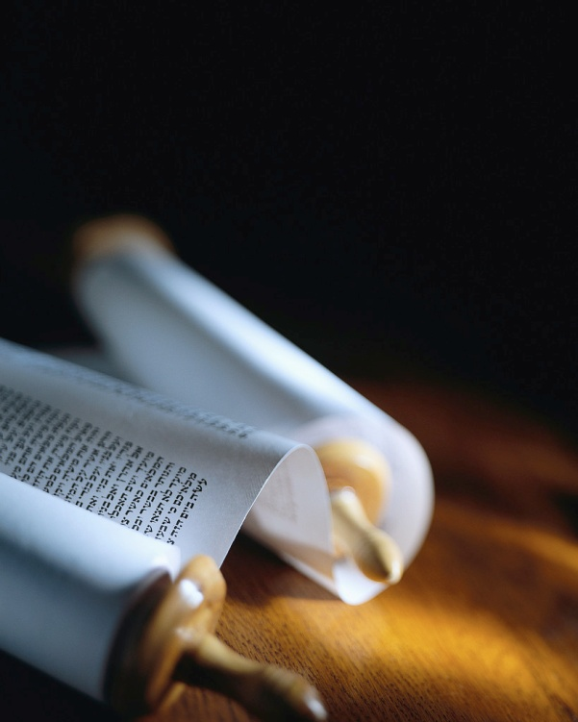
Next
Notes:
Let’s remember the mission of every true Christian :
1) You will be My witnesses. A1v8
2) The Seed is the Word. Lk8v11
3) Become Fishermen. Mk1v17
4) Salvation is of the Lord. Jo1v9
5) Make disciples. Mt28v19
But, can we know they are saved ?

Slide 2
Signs of Salvation
There once was a man in the land of Uz named Job. The man was blameless as well as upright. He feared God and kept away from evil. Job 1:1
Practice good
Preach grace
Pray for others
Was Job truly saved ?
Next
Notes:
Jesus said, ‘By their fruit you will know them’ ≠ the fruit of HS !
Today we’ll see 3 signs of salva.
I’ll be using the ISV literal transl
Let’s read Job1v8-11. [Read]
Job was “blameless”. [Read]
[Read] Today we will see that signs ≠ the Way to salvation !

Slide 3
He did many good deeds.
He would offer a burnt offering for each one, because Job thought, "Perhaps my children sinned by cursing God in their hearts." Job did this time and again. Job 1:5
Practice good
Preach grace
Pray for others
Did he sacrifice for himself ?
Next
Notes:
Let’s read Job1v8. [Read]
The book about Job tells of his many good deeds for others.
He sacrificed for his children, but did they repent of their sin ?
Correct behavior is a good sign of true salvation, but…
Did he recognize his own need?

Slide 4
He was thinking like his friends.
Why haven't you pardoned my transgression and taken away my iniquity ? Now I'm about to lie down in the dust. You will seek me diligently, but I won't be around!" Job 7:21
Practice good
Preach grace
Pray for others
He knew he was not truly saved.
Next
Notes:
Let’s read Job7v21. [Read]
Several times Job agrees with his 3 friends saying good deeds lead to salvation. (cf. Job9v2)
He admitted his sin, but never repents, nor asks for forgiveness.
He knew life was too short to make up for his sins.

Slide 5
Job knew integrity was a good sign.
Far be it from me to admit that you're right ! I intend to maintain my integrity even if it kills me ! Job 27:5
Practice good
Preach grace
Pray for others
“I despise myself and repent !”
Next
Notes:
Let’s read Job27v5. [Read]
Practicing good IS an excellent sign of true salvation.
Good deeds w/o repentance is of no avail to obtain true salvation
PTL, God in His mercy brought Job to true repentance.
Job42v6 says,… [Read]

Slide 6
Who is Elihu ?
I'm just like you are. I, too, have been pinched off from a piece of clay. Don't be afraid of me ; I'll go easy on you." Job 33:6-7
Practice good
Preach grace
Pray for others
“True salvation is a gift.”
Next
Notes:
Let’s read Job33v6-7. [Read]
His lineage is given in Job32v2.
He is not the Son of God !
He’s just a man who “got it” !
He is not condemned by God, like Job’s 3 friends. (cf. Job42v7)
Unlike Job & his friends, Elihu never puts good deeds first.

Slide 7
Job couldn’t refute the truth.
"What man is like Job, who drinks mockery like water, Job 34:7
Practice good
Preach grace
Pray for others
Grace is not for the righteous.
Next
Notes:
Let’s read Job34v7. [Read]
“The truth hurts”, but it’s good.
This was tough love.
Job needed to be reminded of his sin and need for salvation.
Elihu sounds like the 3 friends, but what follows is different.
He didn’t say “redeem yourself”

Slide 8
You can’t receive salvation by works.
If you are righteous, what will you add to him ? What can God receive from your efforts ? Job 35:7
Practice good
Preach grace
Pray for others
We can’t pay for true salvation.
Next
Notes:
Let’s read Job35v7. [Read]
True salvation according to the Old and New Testament is a gift.
No one can earn nor merit it.
Job & his 3 friends and many people today miss this truth !
All have sinned & all need to ask for the gift of salvation.

Slide 9
So what did Elihu say to do ?
Let him pray to God and he will accept him ; he will appear before him with joyful shouts !" …'I've sinned. I have twisted what is right. Yet he has not repaid me like I deserve. He has redeemed my soul from going down to the Pit. Job 33:26-28
Practice good
Preach grace
Pray for others
Job knew Elihu was right !
Next
Notes:
Let’s read Job33v26-28. [Read]
We can’t pay for salvation, but we can pray for it.
That requires faith !
Rm 10v9 says, “Whoever calls on the Name of the Lord will be saved !”
“I know my Redeemer Lives!”

Slide 10
A sign of salvation is passing it on !
My servant Job will pray for you. I'll encourage him by not responding as your disgraceful folly deserves, since you didn't speak about me correctly as did my servant Job. Job 42:8
Practice good
Preach grace
Pray for others
Freely receive, freely give.
Next
Notes:
Let’s read Job42v8. [Read]
It must have taken a lot of grace to pray for his “friends”.
God promises to respond to Job’s prayer !
They too needed God’s grace.
Jesus said in Mt10v8, “Freely ye have received, freely give.”

Slide 11
Biblical chronology is important.
The LORD restored Job's prosperity after he prayed for his friends. The LORD doubled everything that Job had once possessed. Job 42:10
Practice good
Preach grace
Pray for others
When do you pray ?
Next
Notes:
Let’s read Job42v10. [Read]
Job was still poor, without children, terribly ill… and yet he prayed for his “friends”.
He didn’t pray for his own restoration to health and wealth !
Prayer for others is a real good sign of true salvation.

Slide 12
Review, React, Return
Practice good
Preach grace
Pray for others
"As for me, I know that my Vindicator is alive ; and he, the Last One, will take his stand on the soil. Job 19:25
www.Pass4missions.com/library
Notes:
Let’s review what we have seen
Let’s react to what we have learned and not “be hearers” only, but “doers of the Word”.
Let’s return for a checkup each day this week, to let God work.
Let’s look for the signs of salva.
True Salvation is a miracle. [R]

